Slide 1
Staying Safe Online
A MCPL Buddies Program

Slide 2
What is a Buddy Program
Middle Country Teens in grades 6th-12th sit with school-aged children, 3-8 years old and focus on a topic. Book Buddies, Lego Buddies, Math Buddies and Tech Buddies are some examples.
Before sitting with the children teens must go through a training program. Then each buddy session is 1 hour for two weeks. Teens earn community service for participating.

Slide 3
Online Safety Buddy Program
Similar to the already established Buddy Program, the Online Safety Program will pair teens in grades 6th-12th with children 5-8 years old.
Teens must have first completed the Buddy Program Training. They will then get another 1.5 hour training focused on Online Safety.
Following that they will sit with the school aged children for 1 hour for two consecutive weeks teaching them age appropriate online safety information through play and crafts.
During the final session the school-aged children will then teach their adults how to be safe online using what they learned from the teens.

Slide 4
What is being safe online?
For children ages 5-8 they will learn about:
Asking for an adults permission to use a device/website.
What information is okay to share vs what is private.
What websites they can spend more time on vs what to limit.
Mental health safety and how to say goodbye to technology when it’s time to put it down.

Slide 5
Authority on a Topic
Including the Adult
Learning Through Play
Beginner Coding Skills
Online Safety
The child becomes the authority on the topic and gets to show off what they’ve learned.
Emphasizes the importance of the entire family being safe online.
cognitive skills - physical abilities new vocabulary – social skills –
literacy skills
Stranger danger is online as well.

Slide 6
Teen
Online Safety Training

Slide 7
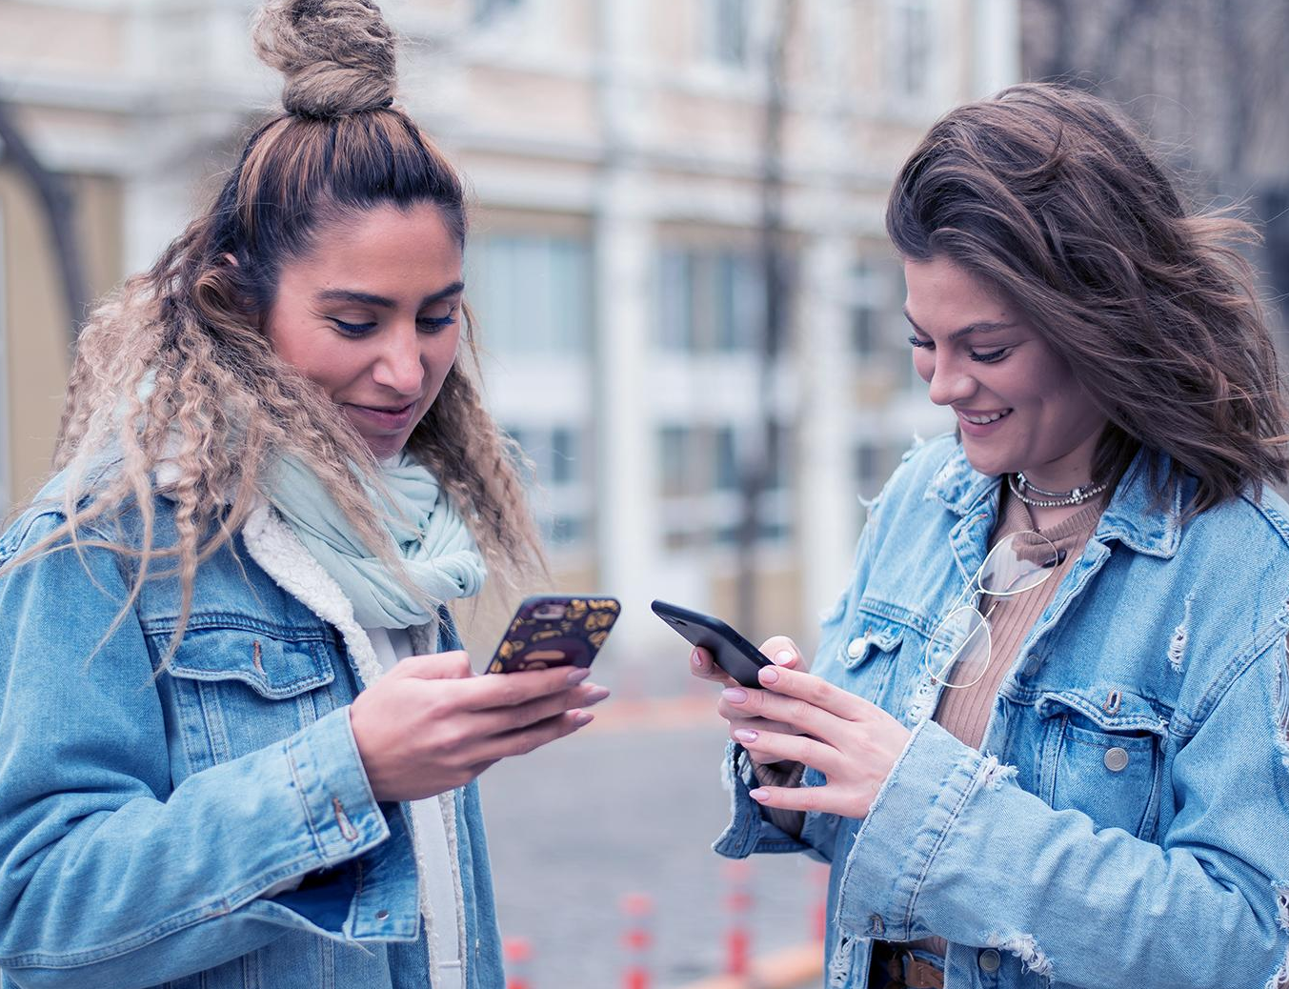
Teen Online Safety Training
1.5hr community service
Data Detox X Youth handout.
Review Strong Passwords and Misinformation portion together.
Discuss facial recognition tech
https://www.youtube.com/watch?v=f5qgOqNQ7zY https://www.youtube.com/watch?v=sYftT5YgwVI
Discuss what we will teach the kids in the following sessions

Slide 8
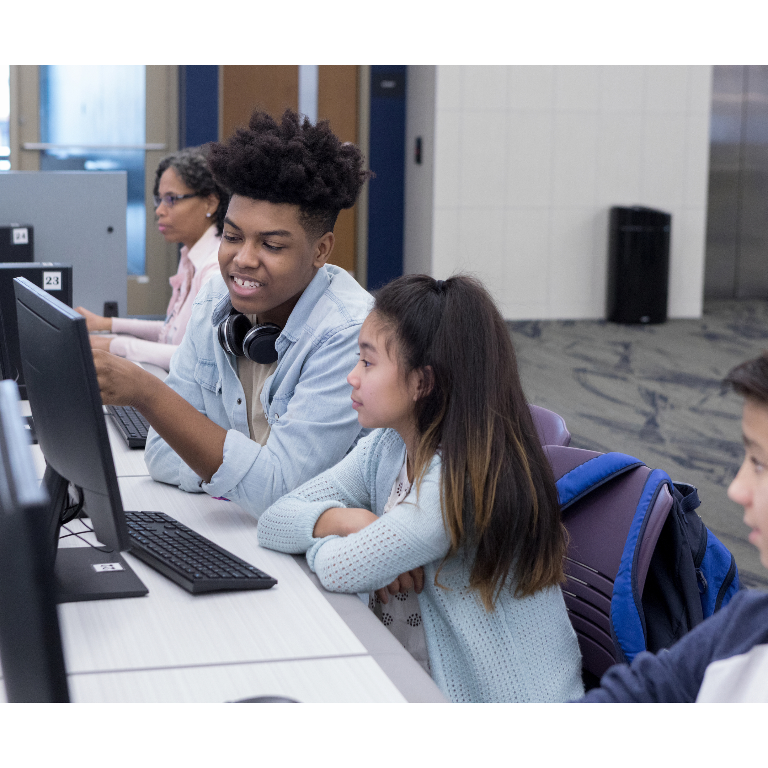
Online Safety Buddy Training - Day 1
Vocab
Poem Poster
NatGeo Kids on iPads
That’s Private!
Coding with BeeBot
Little Buddy will get a packet with worksheets from commonsense media to do with their parents at home.
commonsense.org/education

Slide 9
Fun New Words!
Online/Internet
Website or App
Private
using a computer, phone, or tablet to visit a website or app
a place you can visit online/on the internet
something that you should keep to yourself
commonsense.org/education

Slide 10
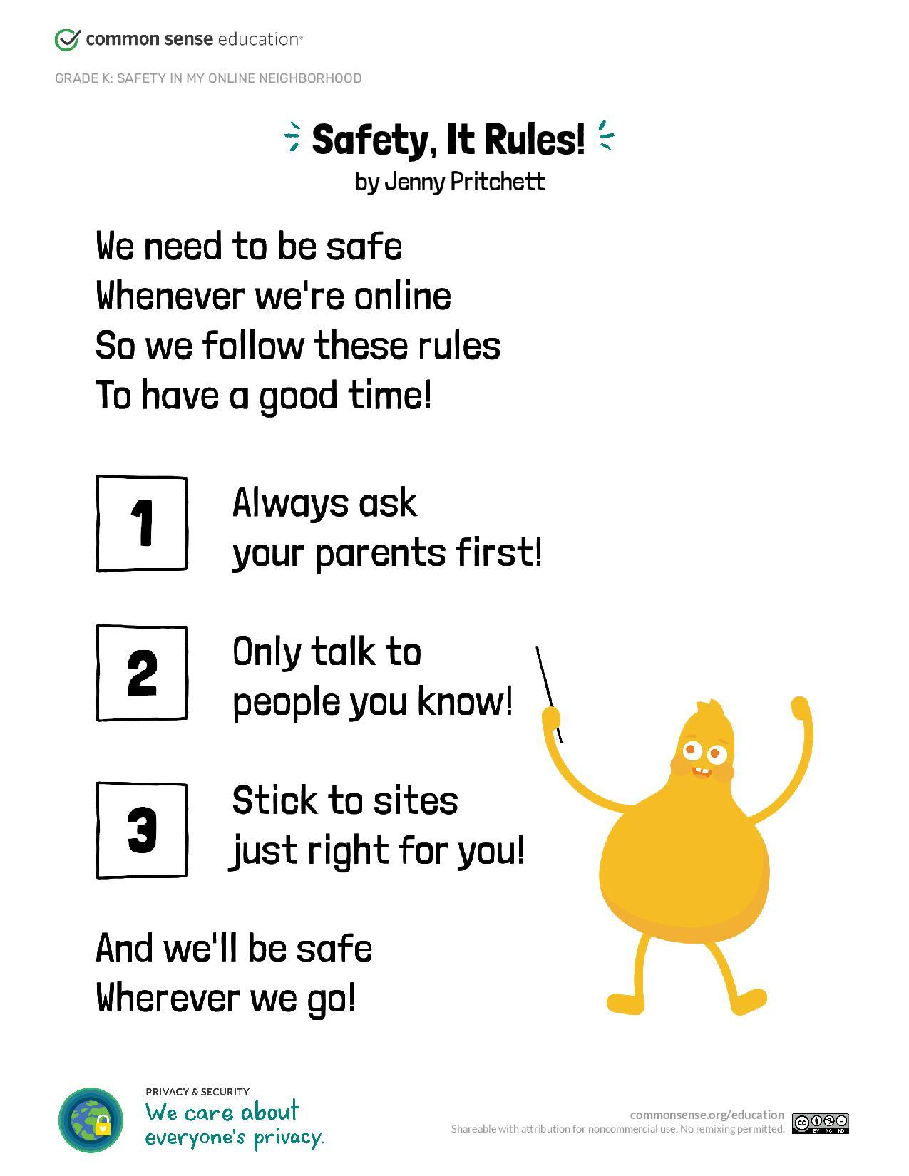
Going Online Poem
commonsense.org/education

Slide 11
That’s Private!
Not Okay to Share
Okay to Share
Name
Address
Phone Number
Password
Birthday
Picture
Parents Names
School
Favorite Color
Favorite Animal
What you ate for dinner
Favorite Ice cream
commonsense.org/education

Slide 12
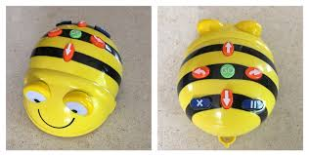
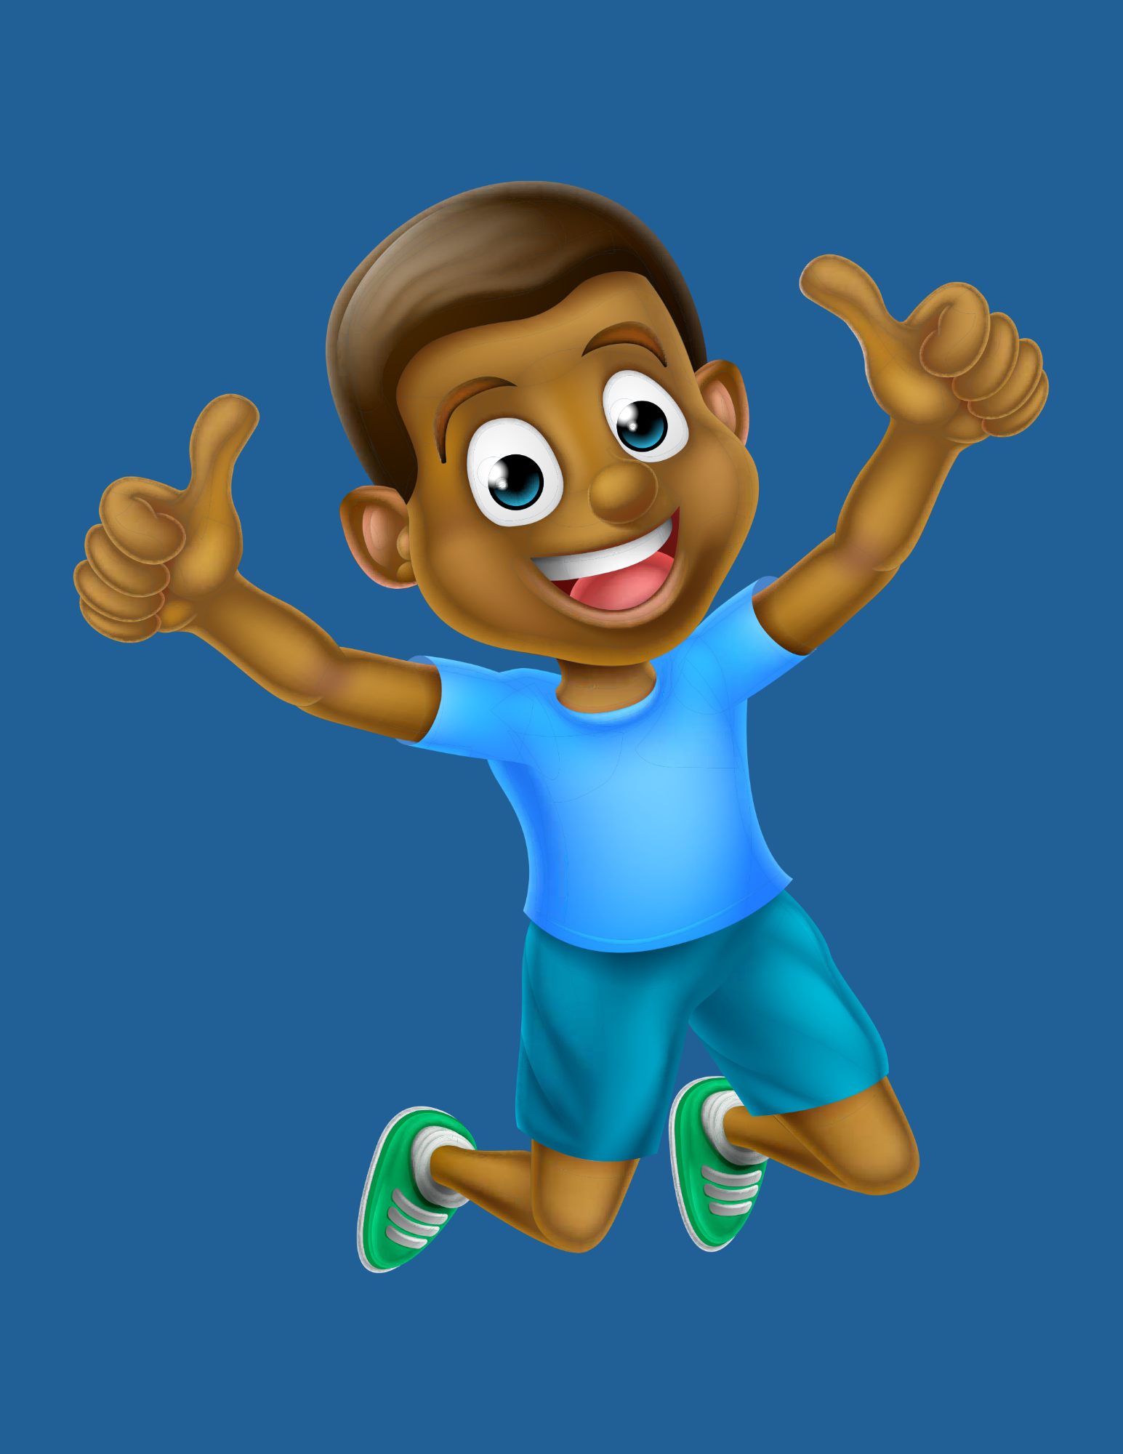
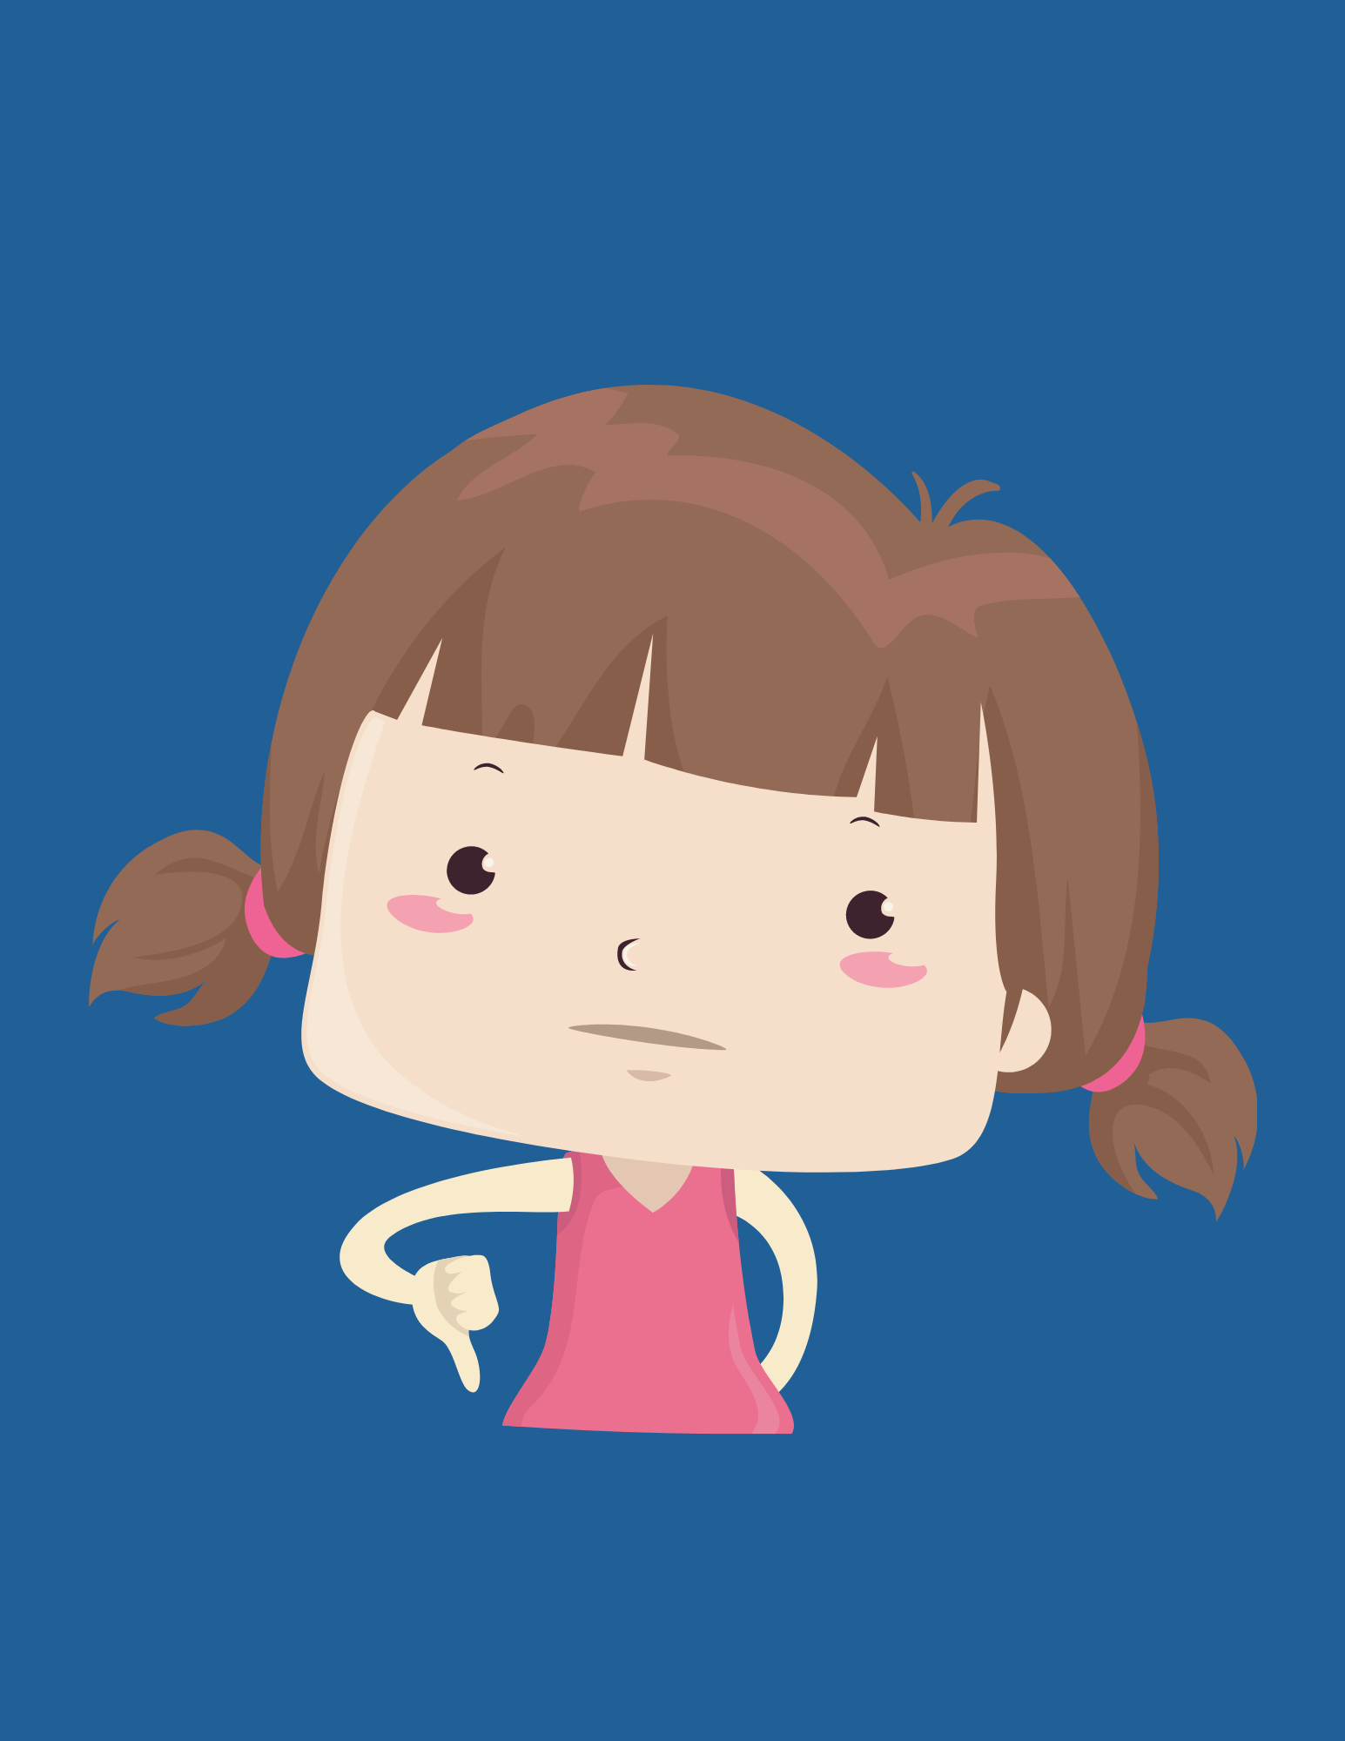
Game Time!
Teens will ask their buddy if a certain piece of information is okay to share online. To answer, the buddy (with help from the teen) will code BeeBot to go to one of the printed cards.
Example: Is it okay to share your name online?
Printed Cards!

Slide 13
Online Safety Buddy Training - Day 2
Vocab
Data Detox Family
Balancing different kinds of screen time
Saying Goodbye to Technology
Pause, Breath, Finish Up Video
Pause, Breath, Finish Up coloring
Sharing what we learned with our Adult(s)
Family Contract
commonsense.org/education

Slide 14
Fun New Words!
Pause
Device
Balance
to stop what you're doing or saying
an electronic piece of equipment like a phone, tablet, or laptop
having equal weight or importance of something
commonsense.org/education

Slide 15
Screen Time!
Fun Screen Time
Sometimes Screen Time
Learn something new!
Draw, code, make!
Go to school!
YouTube & NetFlix
Gaming
Learn your device
https://datadetoxkit.org/en/families/screentime

Slide 16
Saying Goodbye!
Saying Goodbye to Technology
Pause, Breath, Finish Up Video
Pause, Breath, Finish Up coloring

Slide 17
Now YOU’RE the Teacher!
Going Online Poem
Code BeeBot to thumbs up or thumbs down
Let’s Say Goodbye
Family Safety Online Contract

Slide 18
THANKS!
Do you have any questions?
rambonicole@mcplibrary.org
+1-631-585-9393 x241

Slide 19
RESOURCES
Digital Citizenship Curriculm from Common Sense Media
Data Detox Kit Beyond Screens

